Slide 1


Slide 2
The ASINP Project
Strengthening Architectures for the
Security of Identification of Natural Persons
in the EU Member States
Combatting ID-Fraud
Methodology

Slide 3
Comparative study of identity management systems in 17 countries of the European Union :
Context, objectives and method
Federal Public Service Home Affairs
Directorate General Institutions an d Population(www.ibz.rrn.fgov.be)
This publication reflects the views only of the author, and the European Commission cannot be held responsible for any use which may be made of the information contained therein.

Slide 4

Identity
is the relationship between a biological person and a unique set of parameters that describe this person: biometric parameters on the one hand, and societal parameters on the other.
- The societal concept of identity is widely used in civil law in Europe; identity is isomorphic with filiation.
- In the real world: identity is defined by attributes that constitute civil status (patronym and forename(s), date and place of birth, nationality and gender).
- Public identity, original, unique, stable and permanent, is certified and guaranteed by the State; it is the latter that sets the rules according to which the elements that constitute the ID are allocated.

Slide 5
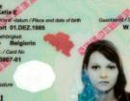
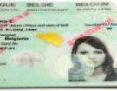
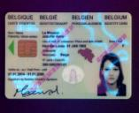
Identity fraud: modus operandi
Because of the security elements, falsification became very difficult
        OVI
        CLI
        UV
        ….
Examples

Slide 6


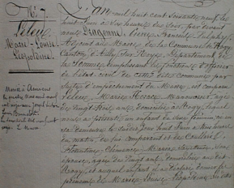
Displacement of fraud
Reinforcement of security measures incorporated into identity documents → fraudsters search for and operate via weak points in the identification chain
Eg: lookalike Declare to be Falsification of source documents

Slide 7
Fraud - the European dimension
Free circulation of people within the EU→
The weaknesses of the system of identification in one EU country have repercussions in other member States.
We are all affected!

Slide 8
The ASINP project: history and context
Initiatives by Belgium during its European Presidency in the field of identity-related crime prevention:
Pilot ASINP project → 8 EU countries : conceptual and contextual study of the system for managing identity in these 8 countries, with analysis of strong and weak points (SWOT).
Idea : extend to other EU countries, within the framework of the Targeted call for proposals process (Financial and economic crime 2010 → programme of grants that mentioned 11 eligible initiatives including: identity theft, preventing and combating identity theft and identity fraud and promoting identity management, facilitating investigations and proceeding within the framework of identity related crime.

Slide 9
The ASINP project: history and context (cont.)
Conference on identity fraud at the European Parliament on 27 - 28 May 2010 (Speakers → presentations on identity fraud, especially in the world of finance and cyberspace.
Preparation of draft conclusions on the prevention of identity-related crime and the fight against this phenomenon and on the management of identity, including the introduction and development of permament and structured cooperation between the member States of the European Union. Adoption by the Council on 2 December 2010.

Slide 10
The ASINP project: history and context (cont.)
Grant Agreement April 2011 with 4 partners : Portugal, Romania, France and the Aliens’ Office.
General invitation to tender for the collection and processing of responses to the ASINP questionnaire on behalf of the Belgian Ministry of the Interior – Directorate-general for Institutions and Population -> awarding of contract to Regioplan. (nov 2011)
Site Survey
Final report

Slide 11
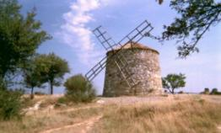



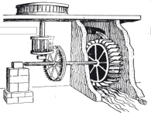


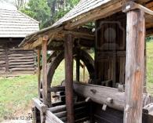
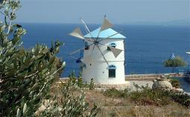
Comparative study: process approach
Diversity of systems → difficult to compare
FRANCE
UNITED KINGDOM
THE NETHERLANDS
HUNGARY
PORTUGAL
SPAIN
ROMANIA
GREECE

Slide 12
Generic approach conceptual and contextual architecture
Makes it possible to:
compare systems in terms of activities, quality and risks
have a standard generic conceptual document on identity management systems based on sub-systems:
- creation
- registration
- copying/use
Objectives:
to identify the strengths and weaknesses of systems by including the trigger event and the implications of the various risks
to compare the different national systems with a view to carrying out a SWOT analysis and determining the measures that may be needed to reduce risks

Slide 13
II. Method : site survey via an online questionnaire
Aim of questionnaire and method
1) Description of activities, informations and participants in the national management system
2) Evaluation of the quality of the various sub-systems and subsequent elements
3) Evaluation by each participating country of the risks with regard to the security of information
The architecture developed in the questionnaire was used during the pilot project.

Slide 14
II. Method : site survey via an online questionnaire (Cont.)
Method
Search for officials responsible for identity management in eu countries: most often, different departments are involved → in general, 1 person per country coordinated the search for information from the relevant departments
Online questionnaire accessible via the Internet : support was given to those persons charged with completing the questionnaire

Slide 15
Questionnaire: 4 sections
The creation process (creation of an official identity)
The process of registering nationals resident in the country (registration of an administrative and mobile identity (ID cards)
The process of registering non-nationals
The process of copying/use

Slide 16
Analysis of answers
For each of these levels : 4 parts:
1) descriptive part: diagram representing each sub-process
2) analysis concerning quality: general evaluationof the sub-process ( Very Weak – Weak – Average – Good – Very Good) and risk analysis : table showing risk aversion
3) analysis of strengths and weaknesses (SWOT)
4) summary by country

Slide 17
Analysis of answers: risk analysis
Probability
Impact
0 = unlikely
1 = probable
2 = Possible
3 = probable
4 = Found
5 = frequent
0 = insignificant
1 = mild
2 = medium
3 = severe
4 = critical
5 = catastrophic

Slide 18
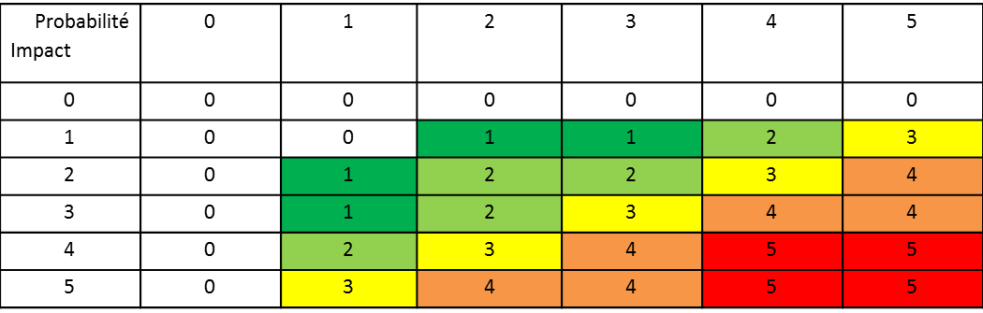
Analysis of answers : table of risks aversion

Slide 19
Analysis of risks: acceptable risk – unacceptable risk
acceptable risk
unacceptable risk
Level 0: no risk
Level 1 : negligible risk (sporadical monitoring the situation)
Level 2: low risk (regular monitoring the situation)
Level 3= average risk/unacceptable : we must put a solution in place within 12 months and periodically monitor
Level 4 : high risk, unbearable: we must put a solution in place within 3 months
Level 5 : vital risk: the solution must be immediate.

Slide 20
III. Structure of questionnaire
The 4 sections
Creation
Registration of nationals
Registration of non-nationals
Copying/use

Slide 21

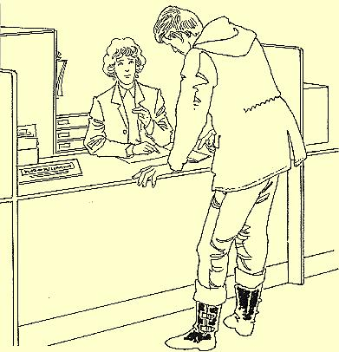
The creation process
Birth

Slide 22
Contextual diagram of creation process
2 events are to be considered: birth (creation) and death (freeze of identity) -> the questions are focused on how these processes are organized in the concerned country
Who notifies ?
Ids
Who checks ?
Who declares and how ?
CREATION
Declaration
Archiving
Transmission
Freeze
Official act
Legal personnality
Who records ?

Slide 23
Creation sub-process: activities, information and participants
For a birth
  Notification and declaration of a birth
  Those concerned
  The authority responsible
  The information appearing on the birth certificate
  Legal personality
  Amendment
  Registration of the birth of a child of foreign nationals and children who are nationals born abroad
For a death
  Notification of death
  The authority responsible
  The information appearing on the death certificate.

Slide 24
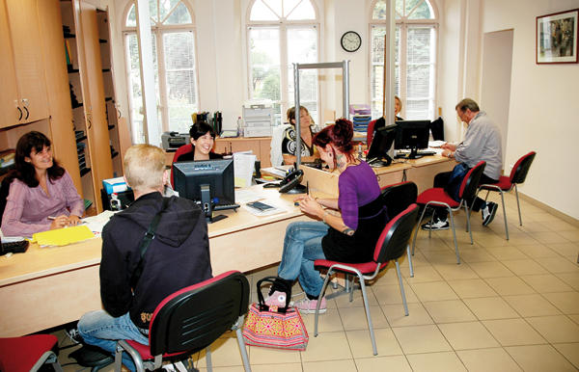
The registration process

Slide 25
National residents

Slide 26
Process for registering national residents (cont.)
Registration of administrative identity Creation and registration of mobile identity
- Type of registration system; - Type of documents;
- Form and content of registration; - Production and issue;
- Transmission – communication;
- Guarantee of unique registration;
- Modification; - Information and signs of confidence
- Deactivation

Slide 27
Conceptual diagram of registration process
Who verifies ?
Registration
-----------------------------
Registration
Modification
Conservation
Deactivation
-----------------------------
Duplication
Administrative identity: Ida
Ido : creation
Mobile identity: Idm
Who checks ?

Slide 28
Non-national residents

Slide 29
Process for registering non-national residents
Registration of administrative identity
Type of registration system
  Source documents
  Transmission
  Guarantee of uniqueness
  Modification
Registration of mobile identity
  Type of document
  Production.

Slide 30
Conceptual diagram of registration process for non-nationals
Who verifies ?
Registration
-----------------------------
Registration
Modification
Conservation
Deactivation
-----------------------------
Duplication
Administrative identity: Ida
Ido : creation
Mobile identity: Idm
Who checks ?

Slide 31
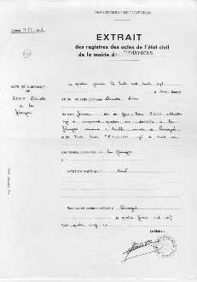
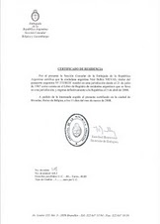
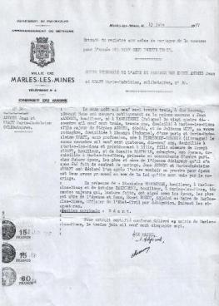
Copying process

Slide 32
Copying process
Copy certified for public use
Types of certified copies
Format of copies
Signs of confidence
Applicants and persons to whom certified copies may be issued
Informal copy for private use
Types of copy authorised for private use
Format of copies
Applicants and persons to whom informal copies may be issued

Slide 33
Conceptual diagram of the copying/use process
Applicant
Who?
Copy/utilisation
-------------------------------
Verification of the copy
Ido
Official copy
Who checks ?

Slide 34
Thank you for your attention
Any questions ?

